Slide 1
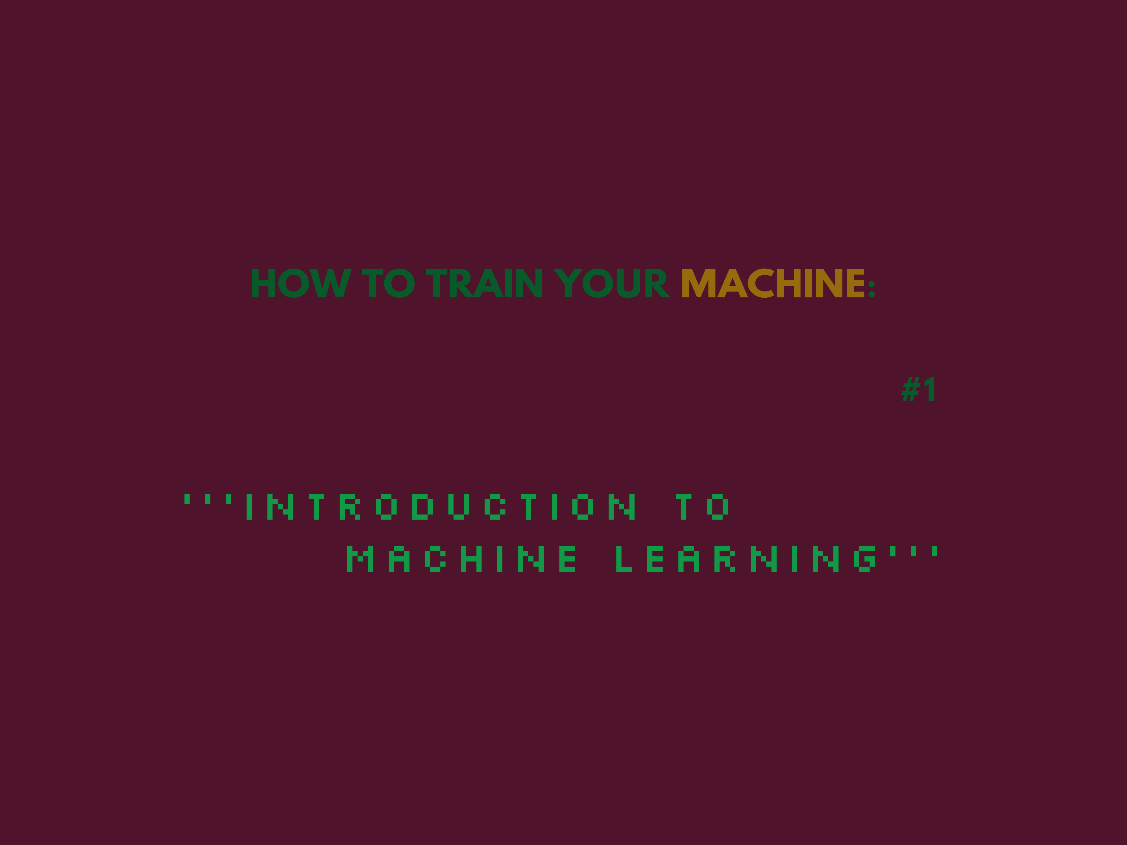
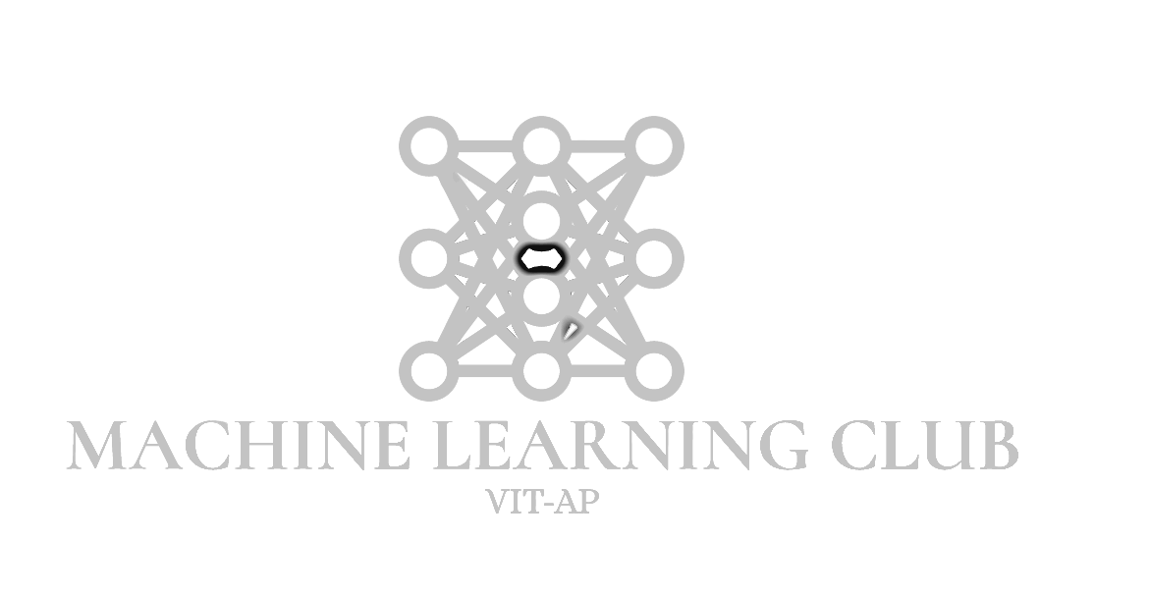

Slide 2
Tom Mitchell (1998) Well-posed Learning Problem: A computer program is said to learn from experience E with respect to some task T and some performance measure P, if its performance on T, as measured by P, improves with experience E.

Slide 3
Machine Learning Algorithms
Supervised Learning
Unsupervised Learning
Reinforced Learning

Slide 4
SUPERVISED LEARNING

Slide 5
Supervised Learning
Classification
Regression

Slide 6
Example 1:
Given data about the size of houses on the real estate market, try to predict their price. Price as a function of size is a continuous output, so this is a regression problem.
Notes:
We could turn this example into a classification problem by instead making our output about whether the house "sells for more or less than the asking price." Here we are classifying the houses based on price into two discrete categories.

Slide 7
Example 2:
Regression - Given a picture of a person, we have to predict their age on the basis of the given picture
(b) Classification - Given a patient with a tumor, we have to predict whether the tumor is malignant or benign.

Slide 8
UNSUPERVISED
Notes:
Unsupervised learning allows us to approach problems with little or no idea what our results should look like. We can derive structure from data where we don't necessarily know the effect of the variables.
We can derive this structure by clustering the data based on relationships among the variables in the data.
With unsupervised learning there is no feedback based on the prediction results.

Slide 9
Example:
Clustering: Take a collection of 1,000,000 different genes, and find a way to automatically group these genes into groups that are somehow similar or related by different variables, such as lifespan, location, roles, and so on.
Non-clustering: The "Cocktail Party Algorithm", allows you to find structure in a chaotic environment. (i.e. identifying individual voices and music from a mesh of sounds at a cocktail party).

Slide 10
Model Representation

Slide 11
To describe the supervised learning problem slightly more formally, our goal is, given a training set, to learn a function
h : X → Y ,
so that h(x) is a “good” predictor for the corresponding value of y.
For historical reasons, this function h is called a hypothesis. Seen pictorially, the process is therefore like this:
Notes:
x^{(i)} to denote the “input” var
$y^{\left(ⅈ\right)}$ to denote the “output” or target var
(x^{(i)},y^{(i)}) is called a training example
X = Y = ℝ.
h : X → Y so that h(x) is a “good” predictor for the corresponding value of y.

Slide 12
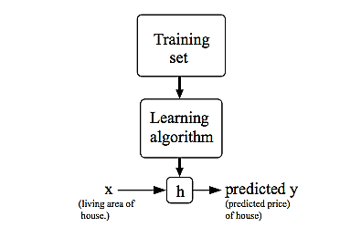
Notes:
target variable that we’re trying to predict is continuous, a regression problem
When y can take on only a small number of discrete values , we call it a classification problem.

Slide 13
Cost Function

Slide 14
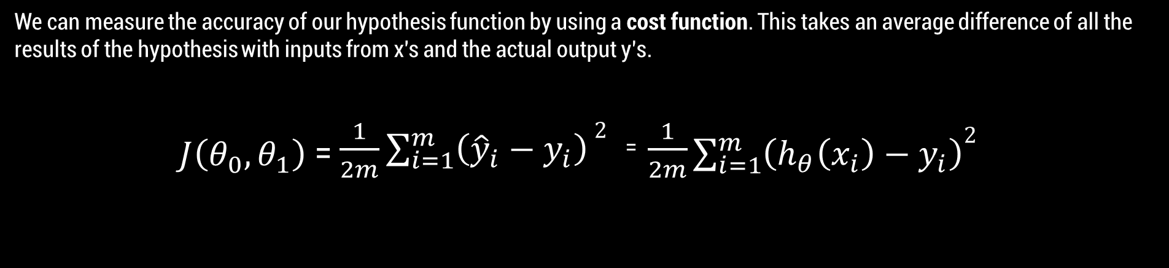
We can measure the accuracy of our hypothesis function by using a cost function. This takes an average difference of all the results of the hypothesis with inputs from x's and the actual output y’s.
$J\left(θ_{0},θ_{1}\right)$ = $\frac{1}{2m}\sum_{i=1}^{m}{\left({\hat{y}}_{i}−y_{i}\right)}2^{}$⁼ $\frac{1}{2m}$ $\sum_{i=1}^{m}{\left(h_{θ}\left(x_{i}\right)−y_{i}\right)2^{}}$
Notes:
Mean Square Error

Slide 15
GRADIENT DESCENT

Slide 16
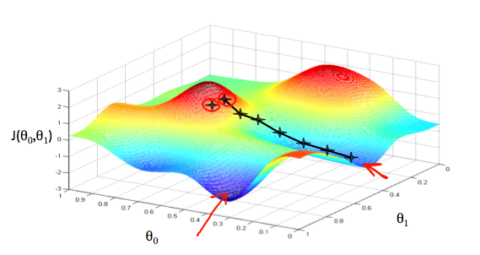
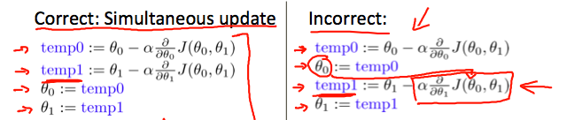
Notes:
Show parabolic curve with learning rate alpha. Show how it always tries to converge. Also show how small value is better than large one.

Slide 17
BIAS VARIANCE TRADE OFF
Notes:
In supervised machine learning an algorithm learns a model from training data.
The goal of any supervised machine learning algorithm is to best estimate the mapping function (f) for the output variable (Y) given the input data (X). The mapping function is often called the target function because it is the function that a given supervised machine learning algorithm aims to approximate.

Slide 18
The prediction error for any machine learning algorithm can be broken down into three parts:
Bias Error
Variance Error
Irreducible Error
Notes:
The irreducible error cannot be reduced regardless of what algorithm is used. It is the error introduced from the chosen framing of the problem and may be caused by factors like unknown variables that influence the mapping of the input variables to the output variable.

Slide 19
Bias are the simplifying assumptions made by a model to make the target function easier to learn.
Generally, parametric algorithms have a high bias making them fast to learn and easier to understand but generally less flexible. In turn, they have lower predictive performance on complex problems that fail to meet the simplifying assumptions of the algorithms bias.
Notes:
The irreducible error cannot be reduced regardless of what algorithm is used. It is the error introduced from the chosen framing of the problem and may be caused by factors like unknown variables that influence the mapping of the input variables to the output variable.

Slide 20
Low Bias: Suggests less assumptions about the form of the target function.
High-Bias: Suggests more assumptions about the form of the target function.
Examples of low-bias machine learning algorithms include: Decision Trees, k-Nearest Neighbors and Support Vector Machines.
Examples of high-bias machine learning algorithms include: Linear Regression, Linear Discriminant Analysis and Logistic Regression.

Slide 21
Variance is the amount that the estimate of the target function will change if different training data was used.
The target function is estimated from the training data by a machine learning algorithm, so we should expect the algorithm to have some variance. Ideally, it should not change too much from one training dataset to the next, meaning that the algorithm is good at picking out the hidden underlying mapping between the inputs and the output variables.
Notes:
Machine learning algorithms that have a high variance are strongly influenced by the specifics of the training data. This means that the specifics of the training have influences the number and types of parameters used to characterize the mapping function.

Slide 22
Low Variance: Suggests small changes to the estimate of the target function with changes to the training dataset.
High Variance: Suggests large changes to the estimate of the target function with changes to the training dataset.
Examples of low-variance machine learning algorithms include: Linear Regression, Linear Discriminant Analysis and Logistic Regression.
Examples of high-variance machine learning algorithms include: Decision Trees, k-Nearest Neighbors and Support Vector Machines.
Notes:
Generally, nonparametric machine learning algorithms that have a lot of flexibility have a high variance. For example, decision trees have a high variance, that is even higher if the trees are not pruned before use.

Slide 23
The goal of any supervised machine learning algorithm is to achieve low bias and low variance. In turn the algorithm should achieve good prediction performance.
You can see a general trend in the following:
Parametric or linear machine learning algorithms often have a high bias but a low variance.
Non-parametric or non-linear machine learning algorithms often have a low bias but a high variance.
The parameterization of machine learning algorithms is often a battle to balance out bias and variance.
Notes:
Bias-Variance Trade-Off

Slide 24
The k-nearest neighbors algorithm has low bias and high variance, but the trade-off can be changed by increasing the value of k which increases the number of neighbors that contribute t the prediction and in turn increases the bias of the model.
The support vector machine algorithm has low bias and high variance, but the trade-off can be changed by increasing the C parameter that influences the number of violations of the margin allowed in the training data which increases the bias but decreases the variance.
Notes:
Increasing the variance will decrease the bias.
Talk about bias and variance in terms of error (training set and test set)
Underfitting high bias, Over fitting high variance, linear func non lin in middle high both
Underfitting can be avoided by using more data and also reducing the features by feature selection.
solution to avoid overfitting is using a linear algorithm if we have linear data or using the parameters like the maximal depth if we are using decision trees. + cross validation, early stopping, pruning, feature regularization

Slide 25
Linear Regression

Slide 26
5 Assumptions:
Linear relationship
Multivariate Normality
No or little Multicollinearity
No auto-correlation
Homoscedasticity

Slide 27
The relationship between variables should be linear in nature.

Slide 28
Linear regression analysis requires all variables to be multivariate normal.
This can be checked by a histogram or Q-Q-Plot. Normality can be checked with a goodness of fit test, eg. Kolmogorov-Smirnov test.

Slide 29
Multicollinearity occurs when the independent variables are highly correlated with each other.
Linear regression assumes there is little to no collinearity.

Slide 30
Linear regression assumes that there should be little no autocorrelation in data.
Autocorrelation occurs when the residuals are not independent from each other.
Notes:
In other words, when the value of h(x+1) is not independent from h(x)
Can be checked by scatterplot. Can also be done by Durbin-Watson test.

Slide 31
Finally, homoscedasticity.
In statistics, a sequence of random variables is homoscedastic if all its random variables have the same finite variance.

Slide 32
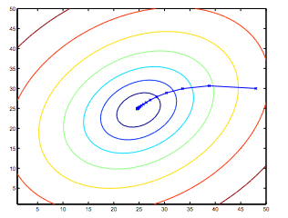
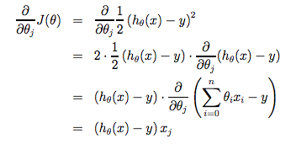

Slide 33

$h\left(x_{i}\right)=θ_{0}+θ_{1}x_{i}$
$y_{i}=θ_{0}+θ_{1}x_{i}+ε_{i}$
$ε_{i}=\left(y_{i}−h\left(x_{i}\right)\right)$
$J\left(θ_{0},θ_{1}\right)=$ $\frac{1}{2m}\sum_{i=1}^{m}{ε_{i}^{2}}$
$θ_{1}=\frac{SS_{xy}}{SS_{xx}}$
$θ_{0}=\overline{y}−θ_{1}\overline{x}$
$SS_{xy}=\sum_{i=1}^{m}{\left(x_{i}−\overline{x}\right)\left(y_{i}−\overline{y}\right)}$ = $\sum_{i=1}^{m}{y_{i}x_{i}}−m\overline{y}\overline{x}$
$SS_{xx}=\sum_{i=1}^{m}{{\left(x_{i}−\overline{x}\right)}^{2}}$ = $\sum_{i=1}^{m}{x_{i}^{2}}−n{\left(\overline{x}\right)}^{2}$

